Slide 1
List of figures

Slide 2
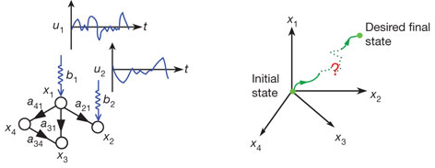
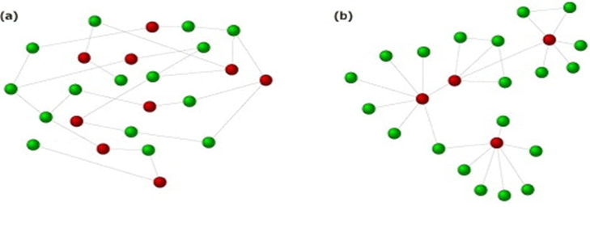
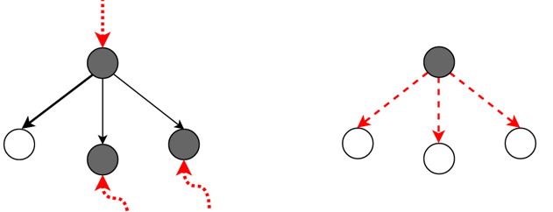
A
B
C
Figure 1. Controllability of networks. (A) Input vector u(t) formed by input signals u_1 (t) and u_2 (t) controls the small network (left). Input control vector u(t) allows to move from an initial state to some desired final state in the state space (right). (B) Example of two network topologies of nodes N = 24 and edges E = 26; random network (left), scale-free network (right). Each green node (dominated) is adjacent to at least one red node (controller). (C) Driver node identification and controllability; MM model (left) and MDS model (right). The grey colored circles are driver nodes, uncolored circles are controlled nodes. In MM controlling is through external signals, while in MDS driver nodes control links individually. Figures were taken from (A), (B) Liu Y.-Y (Liu et al., 2011); (C), (D) from Nacher J. (Nacher and Akutsu, 2012) and (E), (F) from Ravindran V. (Ravindran et al., 2019).

Slide 3
(1) InputFile
(2) KEGG
R_HMR_1638 | v732 | 1.3.3.6
R_HMR_4394 | v2205 | 2.7.1.1
R_HMR_4394 | v2205 | 2.7.1.2
R_HMR_4143 | v2072 | 6.4.1.1
R_HMR_1841 | v786 | 6.2.1.-
KEGG PATHWAY
KEGG….
…..
KEGG ENZYME
KEGG…..
……
Entry | EC 2.7.1.2
Name | Glucokinase, …
Class | Transferases; …
… | ...
Pathway | ec00010 Glycolysis/Gluconeogenesis ec00052 Galactose metabolism … …
…. | …
keggGet(“EC:2.7.1.2”)
KEGGREST
keggInfo()
keggList()
keggFind()
keggGet()
keggConv()
keggLink()
keggDdi()
(3) Lists of pathways
BreastCancer_MDS BreastCancer_nonMDS UrothelialHealthy_nonMDS
List of pathways
………………
………………
………………
………………
………………
………………
………………
List of pathways
………………
………………
………………
………………
………………
………………
………………
List of pathways
………………
………………
………………
………………
………………
………………
………………
(4) Analysis
Unique pathway names,
Abundance of pathways,
Significantly different pathways,
Association of MDS method and health state
Figure 2. Flow chart to get a list of pathways using EC numbers as entries for keggGet() function in KEGGREST package. Dark grey indicates the fields or options used in this project, light red example of enzyme number to be skipped, and light grey indicates fields with secondary relevant information.
Notes:
Figure 1

Slide 4
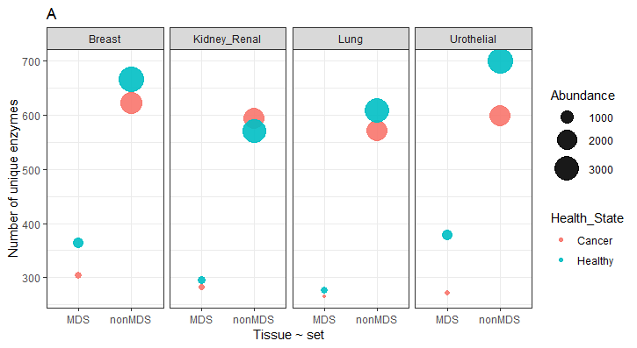
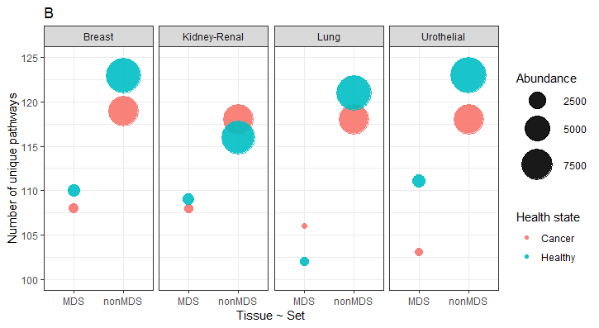
Figure 3. Number of records and abundance. (A) Enzyme codes. (B) Pathway names. Abundance refers to total number of records for each item (enzyme or pathway).
Notes:
Figure 2

Slide 5
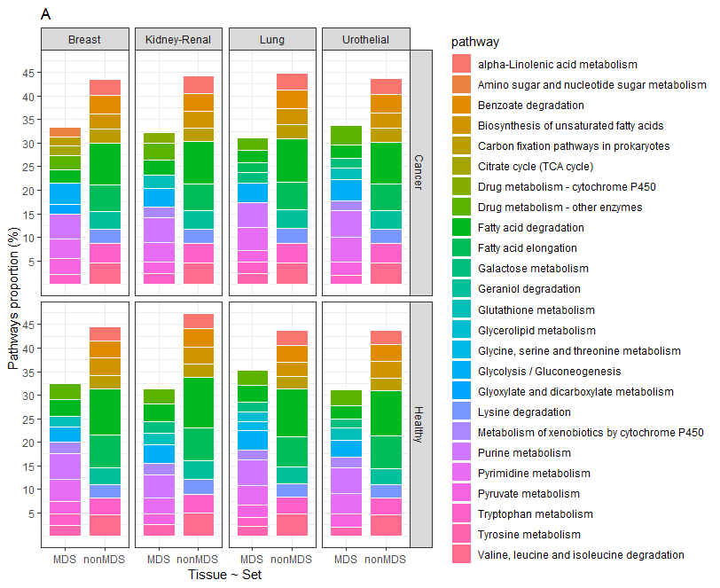
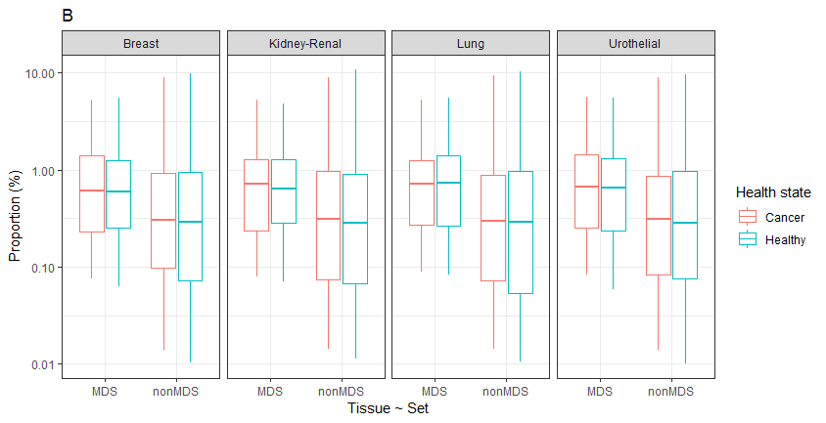
Figure 4. Proportional abundance of pathways by cell-type, health state and set. (A) The ten most enriched pathways. (B) Distribution as percentage of abundance.

Slide 6
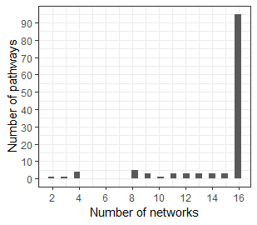
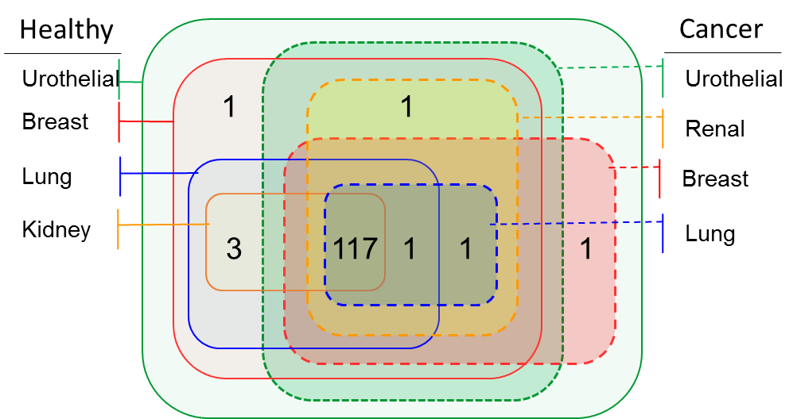
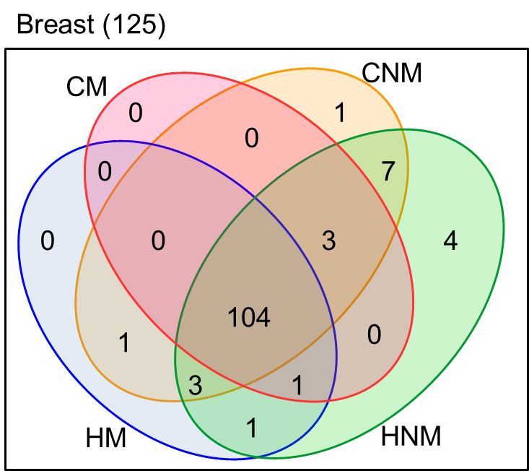
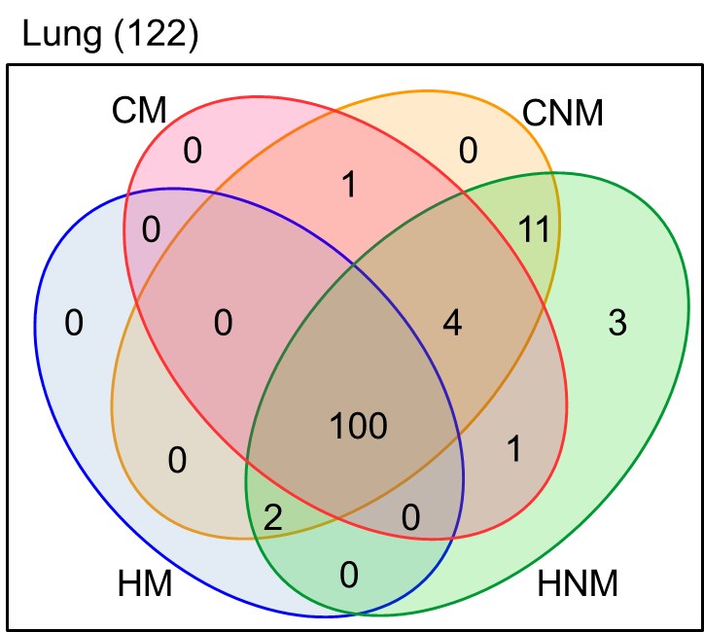
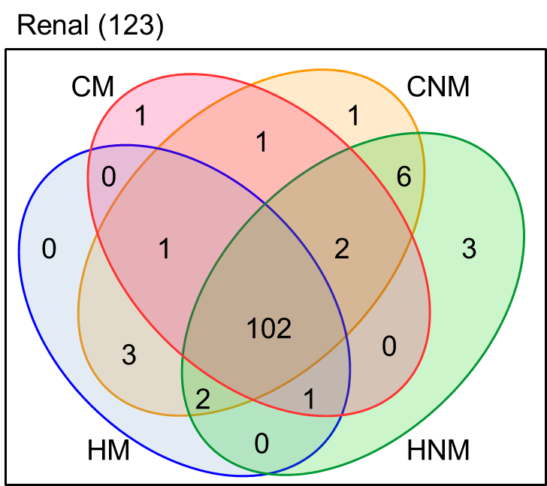
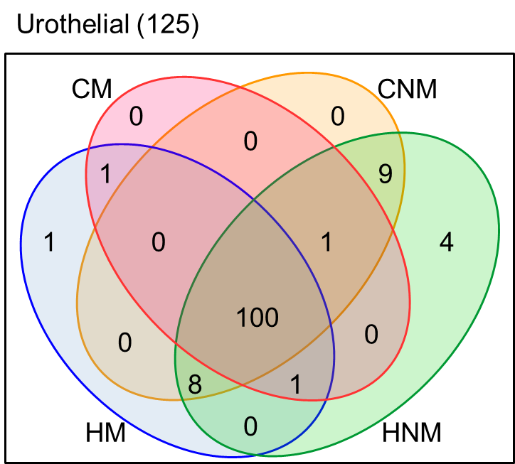
A
B
C
D
E
F
Figure 5. Pathways and distribution on sets. (A) Histogram of pathways shared by networks. (B - F) Venn diagrams with number of shared pathways between datasets. (B) Healthy and cancer tissues. (C – F) Comparison between health status (Cancer, Healthy) by MDS method (MDS, nonMDS). (C) Breast. (D) Lung. (E) Renal. (F) Urothelial. CM: Cancer MDS, CNM: Cancer nonMDS, HM: Healthy MDS, HNM: Healthy nonMDS.

Slide 7
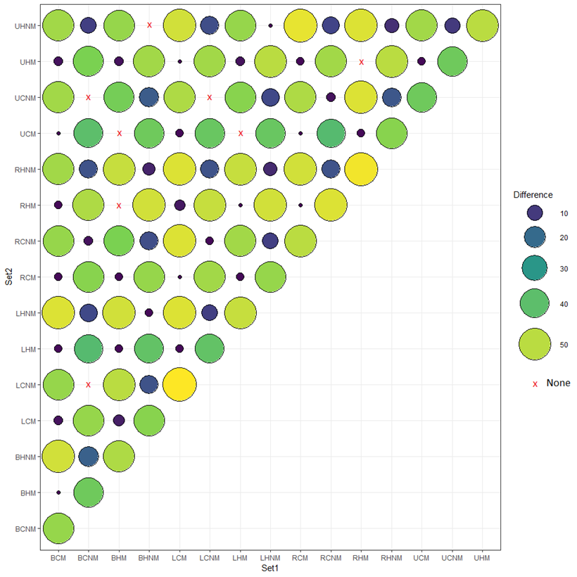
Figure 6. Significantly different pathways between MDS sets (Fisher test, p < 0.05).

Slide 8
List of tables

Slide 9
Category | Enzymes | Records by enzyme | Pathways | Records by pathway
Healthy MDS | 328 | 1.87 | 108 | 13.66
Healthy nonMDS | 636 | 4.68 | 121 | 78.35
Cancer MDS | 281 | 1.66 | 106 | 11.48
Cancer nonMDS | 596 | 3.75 | 118 | 60.00
Table 1. Number of enzyme codes, pathway names and abundance

Slide 11
Table 2. Fold change of pathways abundance from MDS compared to nonMDS set, where proportions are significantly different (Fisher test, p-value <0.05). Each box shows the log10 of fold change. In bold are pathways where MDS method and Health state are significantly correlated (Fisher test, p-value <0.05). Red color scale: reduction in pathway abundance in MDS sets, Blue color scale: increment in pathway abundance in MDS sets. £ Metabolic pathways associated to cancer pathogenesis by Gatto(Gatto et al., 2014). BC: Breast Cancer, BH: Breast Healthy, LC: Lung Cancer, LH: Lung Healthy, RC: Renal Cancer, RH: Kidney (renal) Healthy, UC: Urothelial Cancer, UH: Urothelial Healthy.

